Slide 1

Retail Giant Forecast
Burhanuddin.A.Saboowala

Slide 2
Problem Solving Flowchart
Business And Data Understanding
Data Preparation
Segmentation of Data
Selecting Top Segment
Smoothening of Data
Conversion to Time Series
Segregating Test and Train Data
Model Evaluation
Model Designing

Slide 3
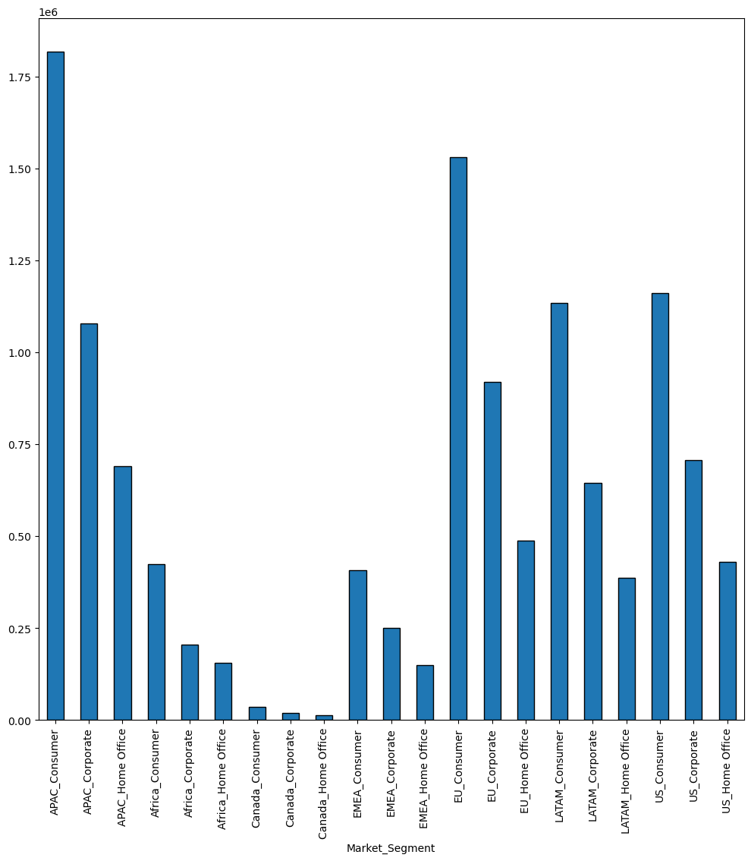
What are the 21 market Segments?

Slide 4
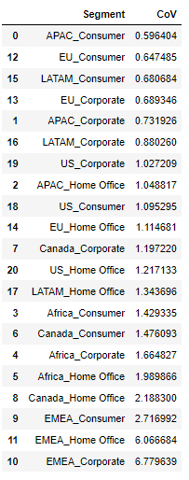
Table of values for the coefficient of variation calculated on the profit for the 21 market segments.

Slide 5
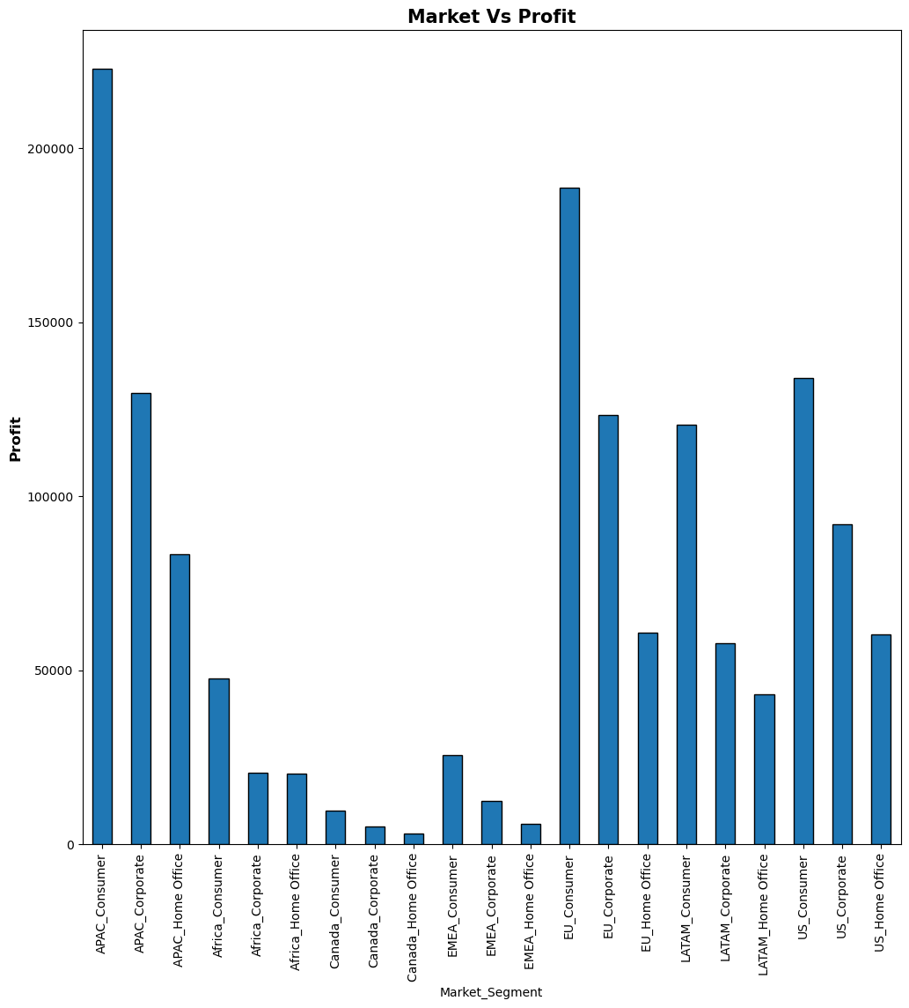
Most Profitable Market Segment
Is APAC_Customer
We have already seen that it has the lowest CoV value.
It is also the most profitable segment as we can see in the table below.

Slide 6
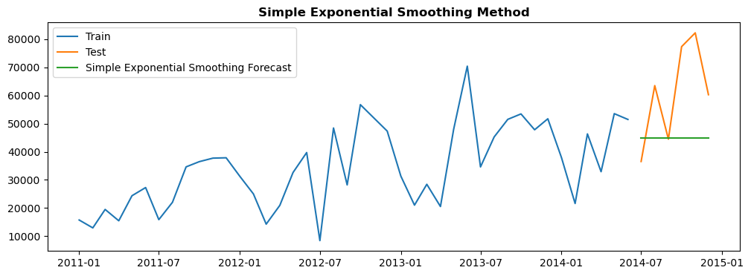
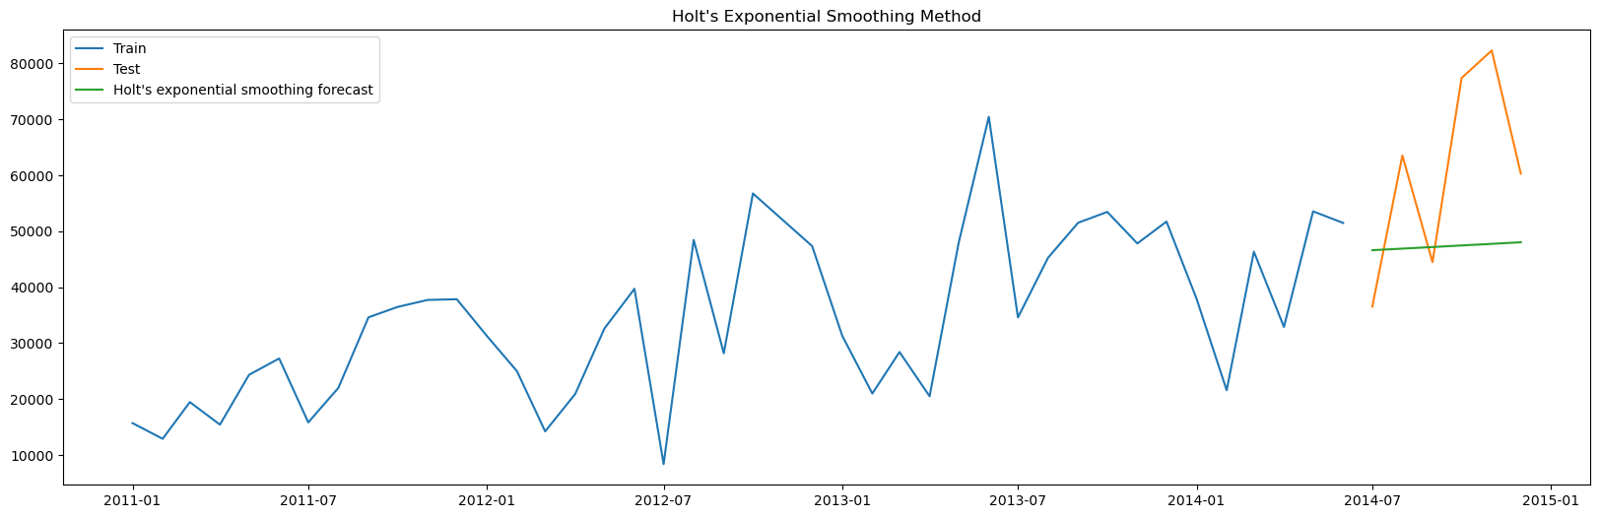
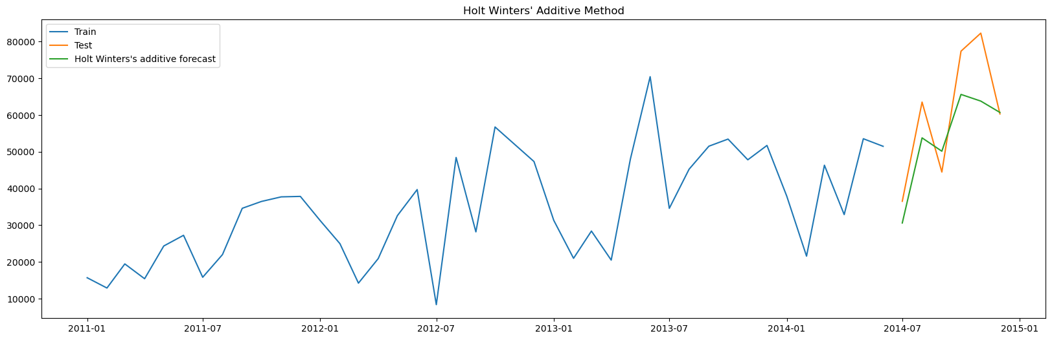
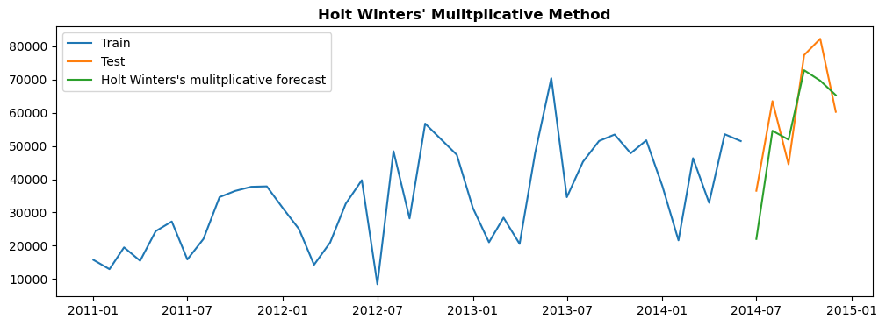
Smoothing Methods Graphs

Slide 7
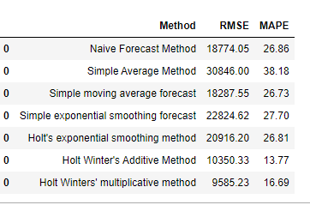
Conclusion
1. Out of all the methods of forecasting we observe that Holt Winter’s Additive Method, Holt Winter’s Multiplicative Method have performed exceptionally well. And this is inline with our expectations. On decomposing the plot itself we had realized that the Sales have a trend and a seasonality. And both these methods of Holt Winter’s capture both unlike other models which can capture either of the two.
2. We also know that a time series of sales data may have some sort of seasonality attached to it as the sales of any item will not remain same throughout the given time period which is usually a year. It may also have a trend either positive or negative associated with it. As a result of this Holt Winter’s Models model are the best suited models for sales forecasting.

